Slide 1
Probability
USC VSoE CSCI 544: Applied Natural Language Processing
Jonathan May -- 梅約納
Nanyun (Violet) Peng -- 彭楠赟
August 31, 2018
based on Kevin Knight's notes

Slide 2
Announcements
HW2 will be out today
HW1 is due 1 week from today
Team recording video? Haven't heard any follow ups
You should be able to register now if you're not already registered; FCFS
No piazza? email cs544@googlegroups.com. (Don't send email to us otherwise. Use piazza)
All quizzes are worth 3% of your grade. There are about 25 quizzes. Co

Slide 3
Definitions
Experiment: Some action that takes place in the world
Outcomes = Sample Space = Ω = the universe; every basic outcome that could happen
Event = A ⊆Ω = something that happened (could be more than one basic outcome)
Probability Distribution: 𝓕: Ω→[0,1], ∑_{x ∈Ω} 𝓕(x)=1 i.e. the values sum to 1 and no value is negative

Slide 4
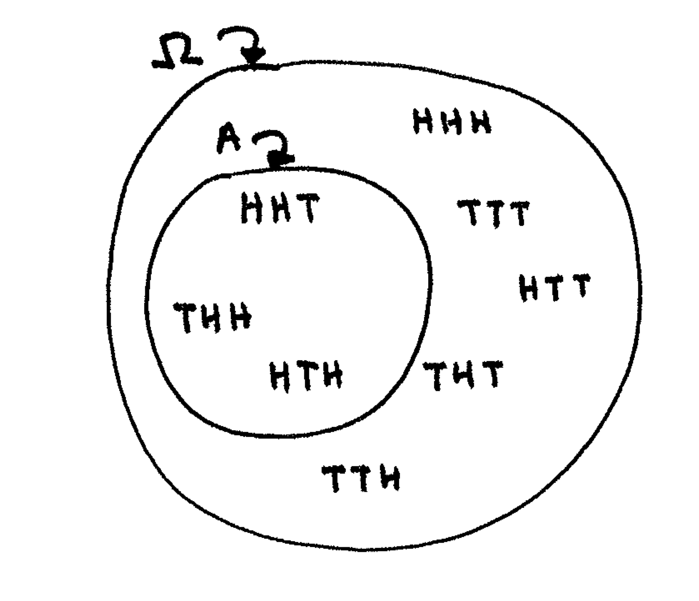
Example
Experiment: "toss a coin three times"
Ω = {HHH, HHT, HTT, HTH, THH, THT, TTT, TTH}
Event A = "exactly two heads" = {HHT, HTH, THH}
Event B = "first one was heads" = {HHT, HTH, HTT, HHH}
Distribution: assign a number between 0 and 1 ("probability") to each basic outcome; sum of all numbers = 1
Uniform distribution: P(x) = 1/8 ∀x ∈Ω
Probability of an event = the sum of the probabilities of its basic outcomes
So, P(A) = ?
P(B) = ?

Slide 5
Joint and Conditional Probability
P(A, B) = P(A∩B) = "joint probability of A and B"
P(A|B) = P(A∩B)/P(B) = "conditional probability of A given B"
P(B|A) = ?

Slide 6
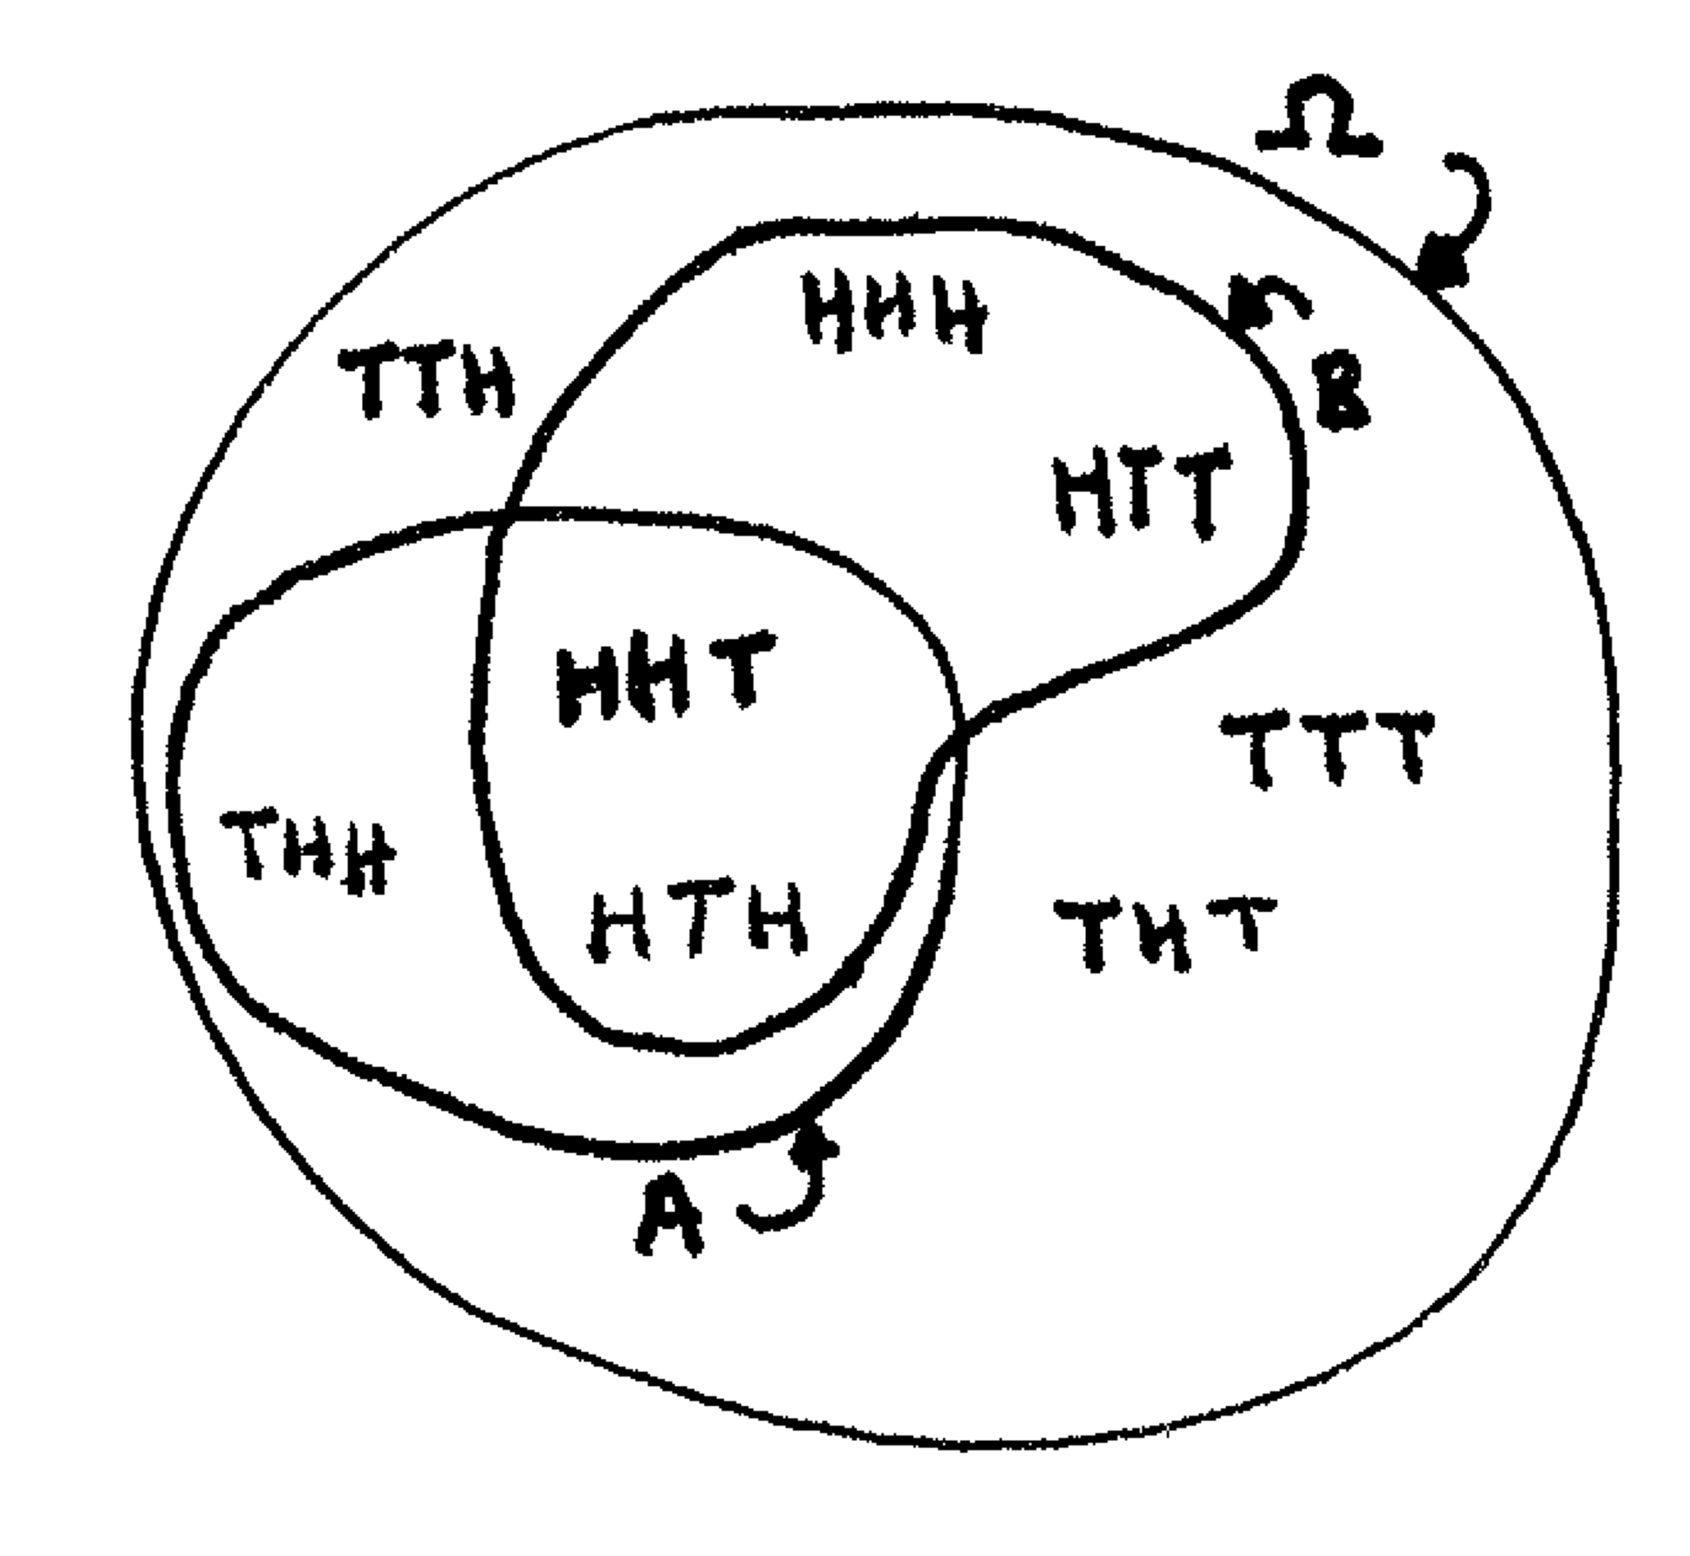
Joint and Conditional Probability
A = "exactly two heads" = {HHT, HTH, THH}
B = "first one was heads" = {HHT, HTH, HTT, HHH}
P(A) = 3/8
P(B) = ½
P(A,B) = P(A) + P(B) ?
No. What is it?
P(B|A) = "if you got 2 heads, what's the chance the first was heads?" = ?
P(A|B) = "if your first was heads, what's the chance you got 2 heads" = ?

Slide 7
Chain Rule of Probability
A₁
A₂
P(A, B) = P(A∩B)
P(A|B) = P(A∩B)/P(B) = P(A, B)/P(B)
Thus, P(A, B) = P(A|B)P(B)
What if we had three events: A₁, A₂, A₃?
Joint probability = P(A₁, A₂, A₃ ) = P(A₁ ∩ A₂ ∩ A₃)
Define " A₂, A₃ " as "B". Then from above, P(A₁, B) = P(A₁|B)P(B)
Now substitute back in: P(A₁| A₂, A₃ )P(A₂, A₃ )
Now rewrite P(A₂, A₃ ) in terms of conditionals: P(A₁| A₂, A₃ ) P(A₂|A₃ )P(A₃)
Notice: P(A₁, A₂, A₃ ) = P(A₃, A₂, A₁ ) = P(A₃| A₂, A₁ ) P(A₂|A₁ )P(A₁)
In general, P(A₁...A_{n}) = P(A₁|A₂...A_{n})P(A₂|A₃...A_{n})...P(A_{n-1}|A_{n})P(A_{n})
A₃
Notes:
Check out the readings about probability in the syllable!

Slide 8
Aside: Ethics
Probability and Statistics have world-beneficial potential
Disease prevention
Economics
Agriculture
Origins?
Pascal and Fermat arguing over games of chance in 1654
Gambling industry exploits disease

Slide 9
Aside: Ethics
AI, NLP also have potential benefit and harm
Reduce miscommunication
Accident prevention
Faster research
Sudden workforce upheaval
Marginalization of some populations
Energy consumption
Spiderman principle: "With great power comes great responsibility"

Slide 10
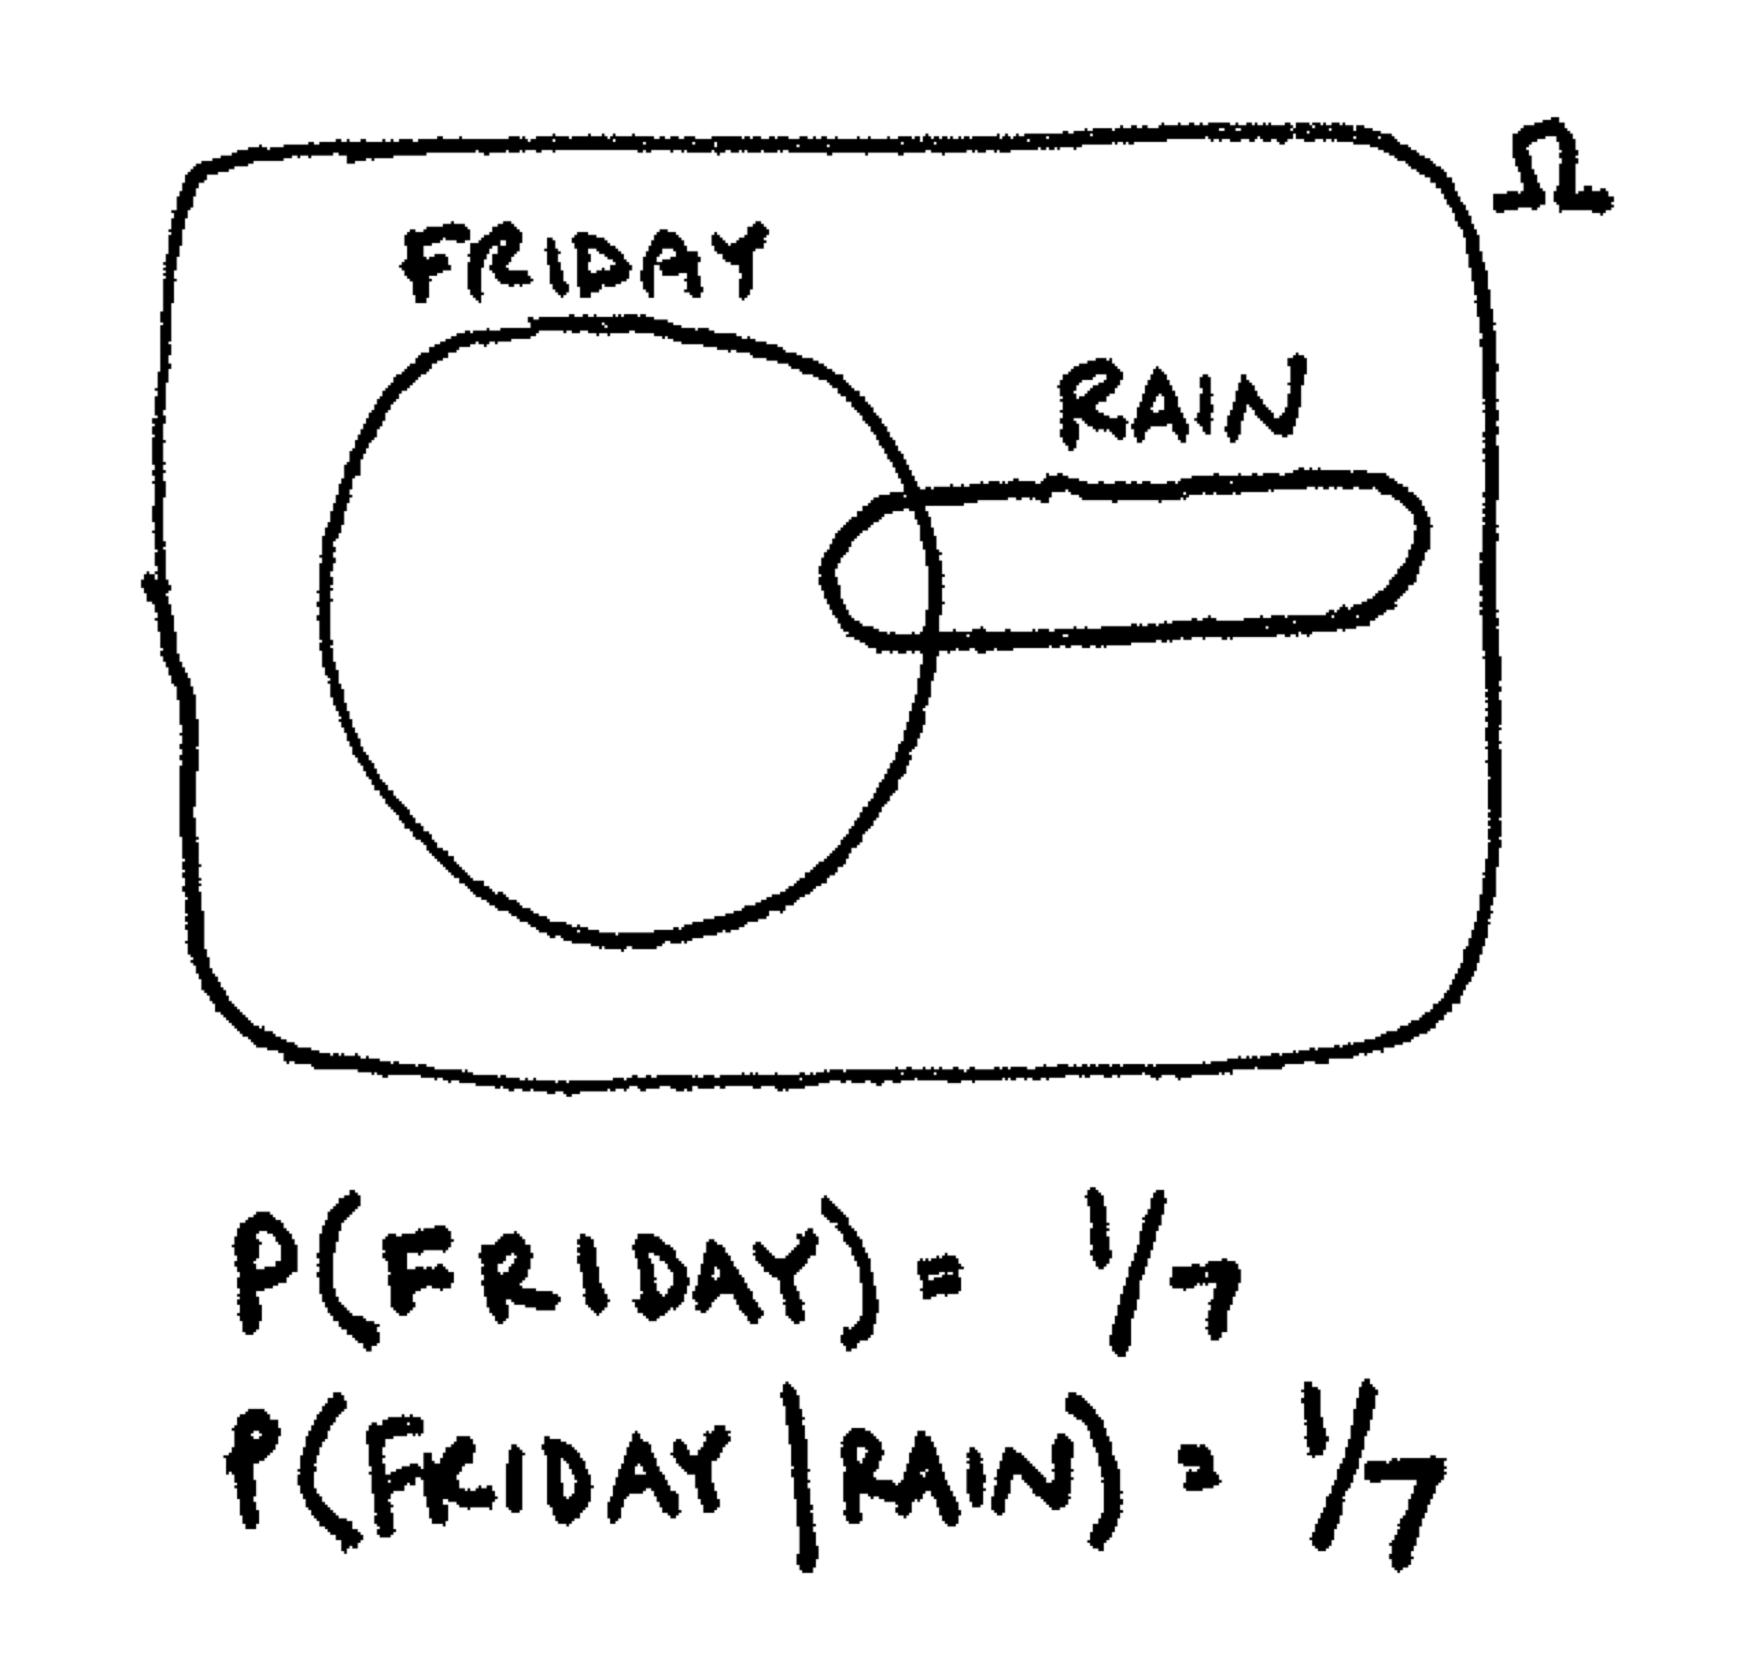
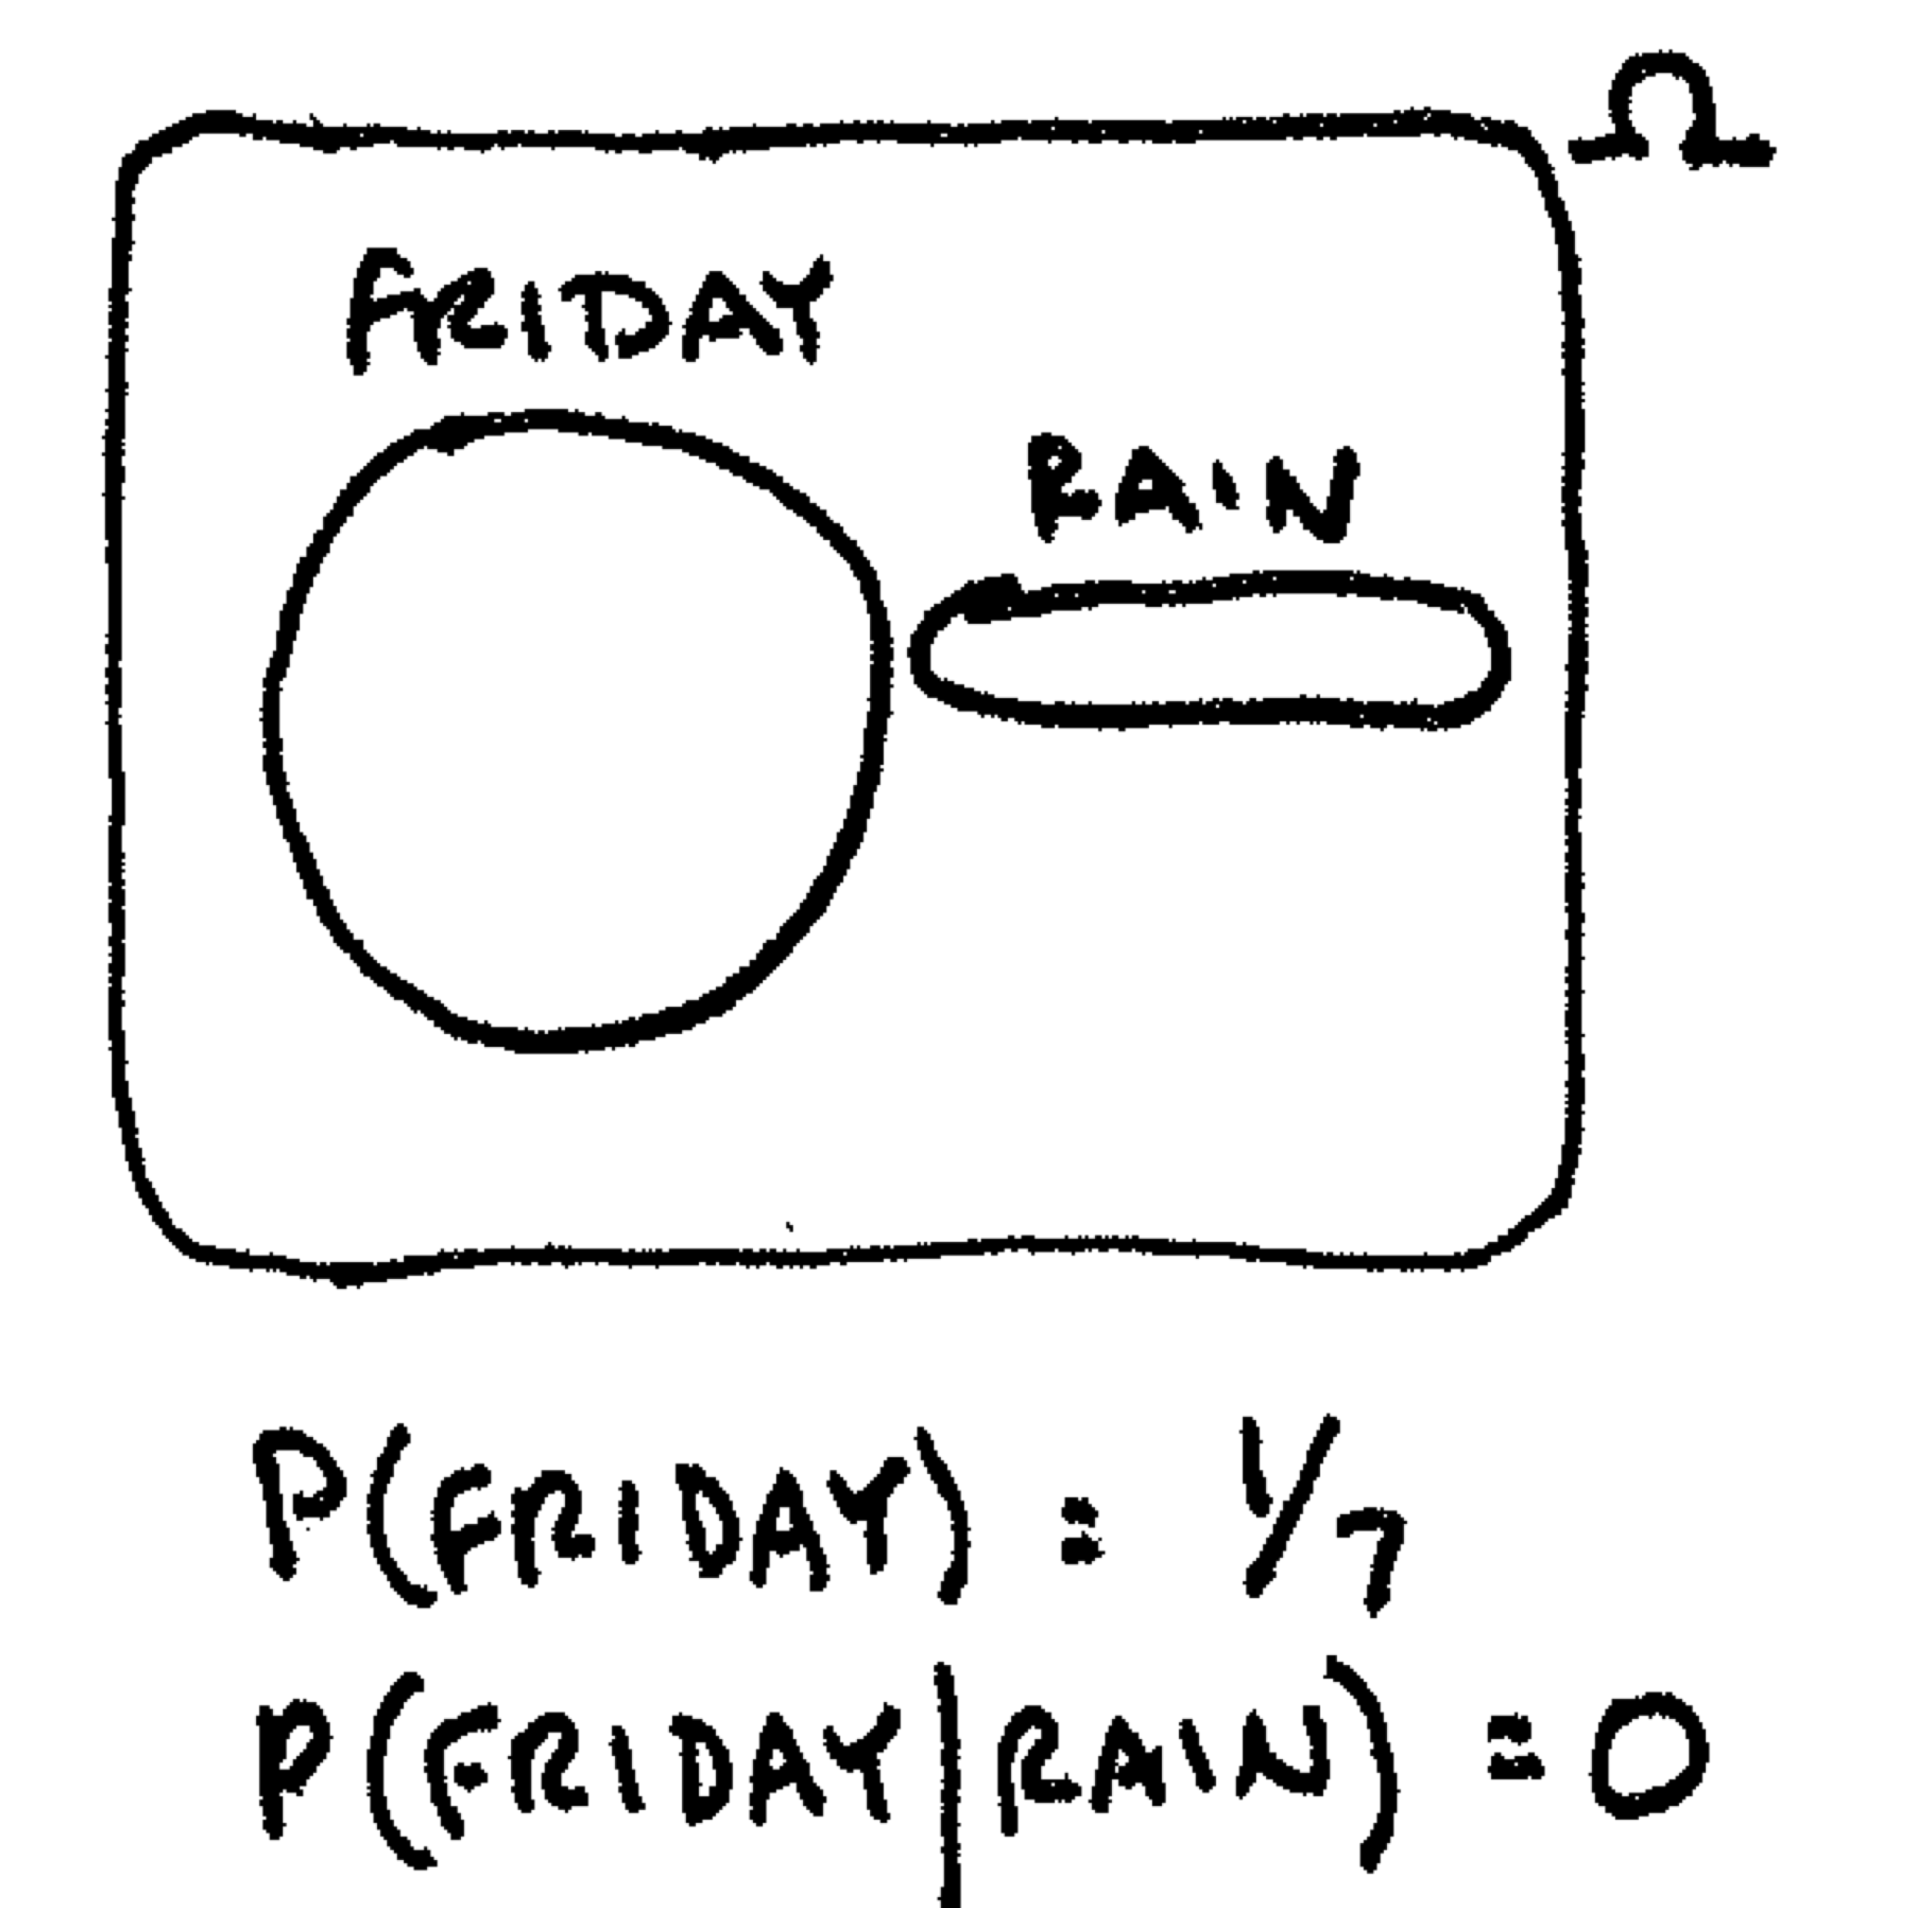
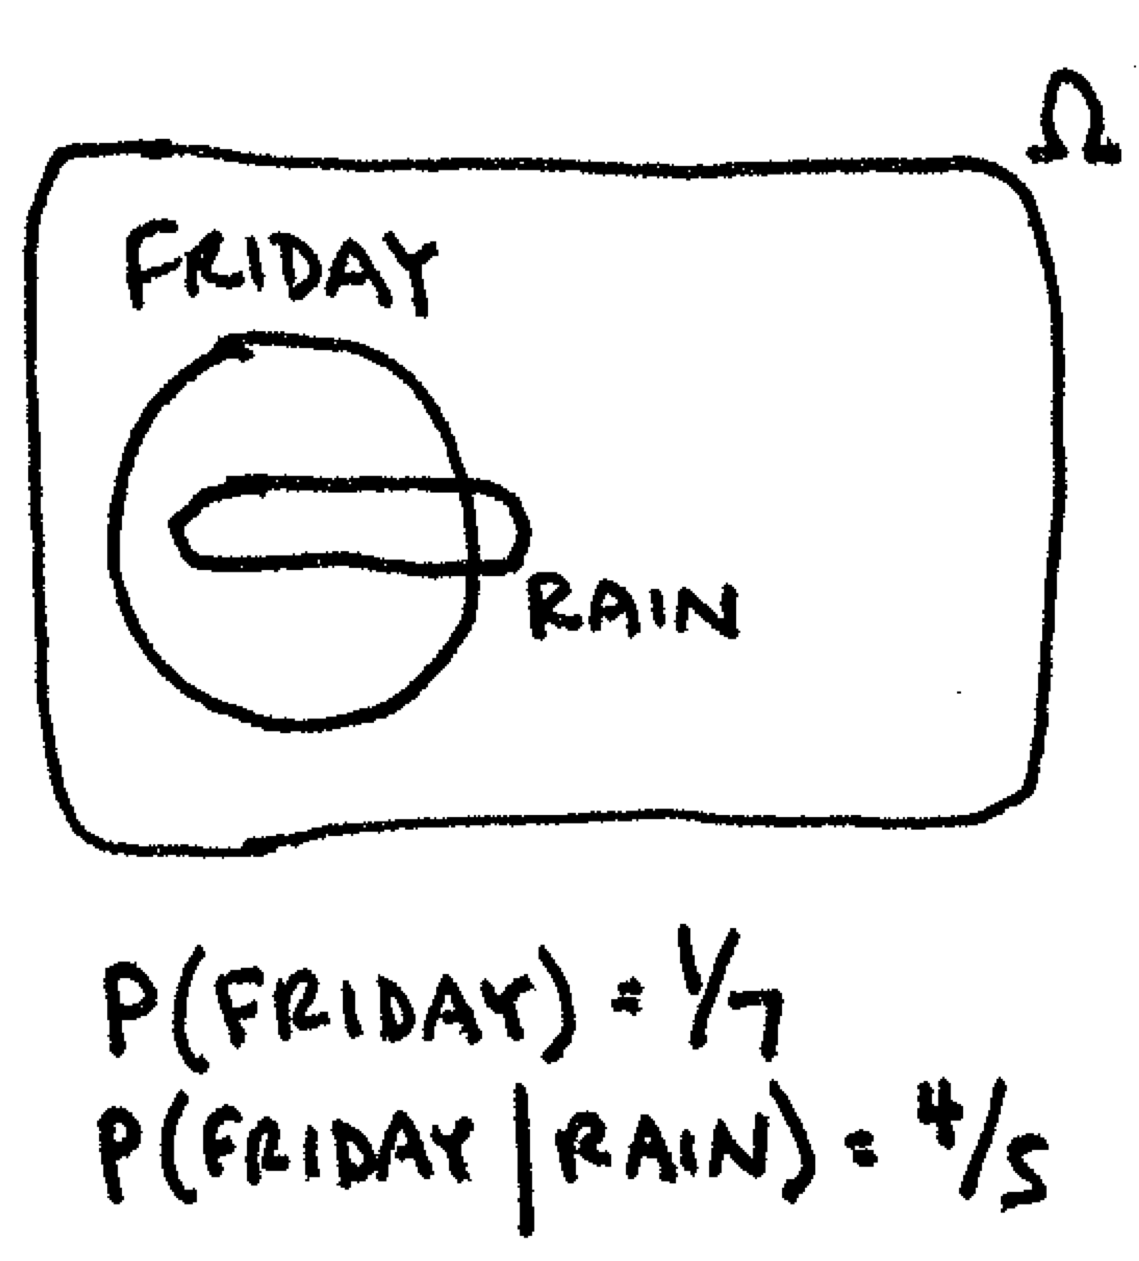

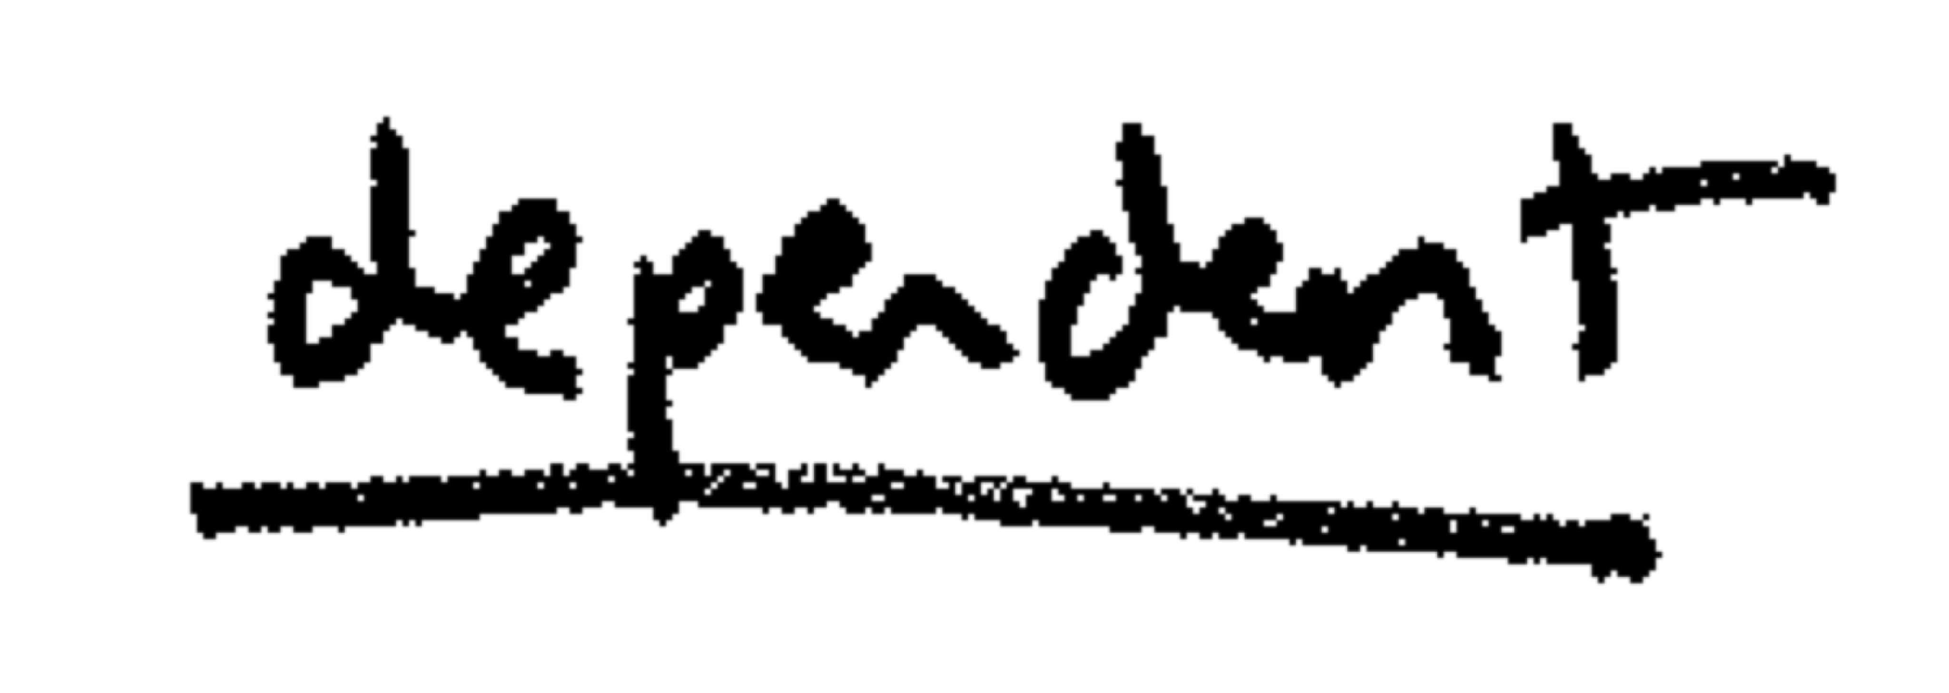

Independence
Events A and B are independent if P(A) = P(A|B)

Slide 11
Bayes' Rule
P(A|B) = P(A, B)/P(B); P(A, B) = P(A|B)P(B)
P(B|A) = P(A, B)/P(A); P(A, B) = P(B|A)P(A)
P(A|B)P(B) = P(B|A)P(A)
P(A|B) = P(B|A)P(A)/P(B)

Slide 12
Law of Total Probability
Let there be events E₁...E_{n} that partition an outcome space (Ω)
∑_{i=1}^{n} P(E_{i}) = 1
0≤P(E_{i})≤1
For any B ⊆Ω
P(B) = ∑_{i=1}^{n} P(B, E_{i})

Slide 13
Using Bayes' Rule and Law of Total Probability
Some people can read minds!
Not very many of them;
P(MR) = 1/100,000
I have invented a mind reader detector test!
If you're a mind reader I can detect this with 95% accuracy : P(T|MR) = 0.95
If you're not, I can detect this with 99.5% accuracy: P(¬T|¬MR) = 0.995
Jill takes the test. The test says "T" (true). How likely is it that Jill is a mind reader?

Slide 14
Jill Passed the Test. Is She a Mind Reader?
P(MR)
MR | .00001
¬MR | .99999
P(MR|T) = ?
P(MR|T) = P(T|MR)P(MR)/P(T)
How do we use P(T|MR) and law of total probability to get P(T)?
P(T) = P(T,MR)+P(T,¬MR)
P(T,MR) = P(T|MR)P(MR) = .95*.00001=.0000095
P(T,¬MR)=P(T|¬MR)P(¬MR) = .005*.99999 = .00499995
P(T) = .00500945
P(MR|T) = .95*.00001/.00500945 ≈ 0.002
P(T|MR) | T | ¬T
MR | .95 | .05
¬MR | .005 | .995
Notes:
P(T) = P(T,MR)+P(T,¬MR) → This is the law of total probability

Slide 15
Argmax and Bayes' Rule
argmax_{Ai}P(A_{i}) ≝ "The A_{i} with highest probability"
A_{i} = {rain, snow, sun}
P(rain) = 0.1; P(snow) = 0.1; P(sun) = 0.8;
argmax_{Ai}P(A_{i}) = ?
Consider argmax in the conditional case
argmax_{Ai} P(A_{i}|B)
= argmax_{Ai} P(A_{i})P(B|A_{i})/P(B)
= argmax_{Ai} P(A_{i})P(B|A_{i})
why?
sun
Notes:
Argmax → the argument that maximize the result
= argmax_{Ai} P(A_{i})P(B|A_{i})/P(B)
= argmax_{Ai} P(A_{i})P(B|A_{i})
* We took the P(B) out because it’s a constant, it wont affect the argmax value

Slide 16
Argmax and Bayes' Rule
argmax_{Ai} P(A_{i})P(B|A_{i}) may be easier to work with than argmax_{Ai} P(A_{i}|B)
Let B be a misspelled character sequence ("limf")
Let A₁...A_{n} be possible corrections ("lime", "limb", "limn")
P(A_{i}|B) = ?
P(A_{i}) * P(B|A_{i})
Can bring more knowledge to help!
keyboard distance?
word likelihood
"We must surgically amputate the limf"
Notes:
"We must surgically amputate the limf"
Given the context, we know that we wanted to type limb instead of limf!

Slide 17


Bayes' Rule and Noisy Channel Model
By reformulating in this way we're taking a particular view of how we view events
P(A_{i})
P(B|A_{i})
A_{i}
B
"fat fingers"
"limb"
"limf"
"language producer"
decode

Slide 18
Estimating Probabilities
How do we get these basic outcome probabilities?
Do experiments!
Find some data (a sample)
Count stuff in the sample
e.g. "how often do sentences start with the word 'So'?
Experiment: Observe sentences that occur in the world
Basic outcomes: {every possible sentence that could occur}
Event A: {sentences that start with 'So'}
P(A) = count of sentences starting with 'So' in the sample/sentences in the sample
P(A|B) = count(A, B)/count(B)

Slide 19
Data and Model
Suppose we have a biased 12-sided die and we throw it repeatedly:
result | count
1 | 0
2 | 7
3 | 26
4 | 45
5 | 119
6 | 70
result | count
7 | 31
8 | 14
9 | 6
10 | 0
11 | 4
12 | 2
It's easy to estimate the 11 free parameters (why 11?)
Total rolls = 324; P(1) = 0/324 = 0; P(5) = 119/324 = .367
P(12) = 1-(P(1)+P(2)+...+P(11))

Slide 20
Data and Model
?
?
What if you only saw the results and weren't told how they were generated?
Another theory: sum of two 6-sided die rolls
What about sum of three 4-sided dice?
In the 2d6 case, P(8) = P(3)P(5) + P(4)P(4) + P(5)P(3)
Now only 5 free parameters
result | count
1 | 0
2 | 7
3 | 26
4 | 45
5 | 119
6 | 70
result | count
7 | 31
8 | 14
9 | 6
10 | 0
11 | 4
12 | 2
Notes:
What about sum of three 4-sided dice?

Slide 21
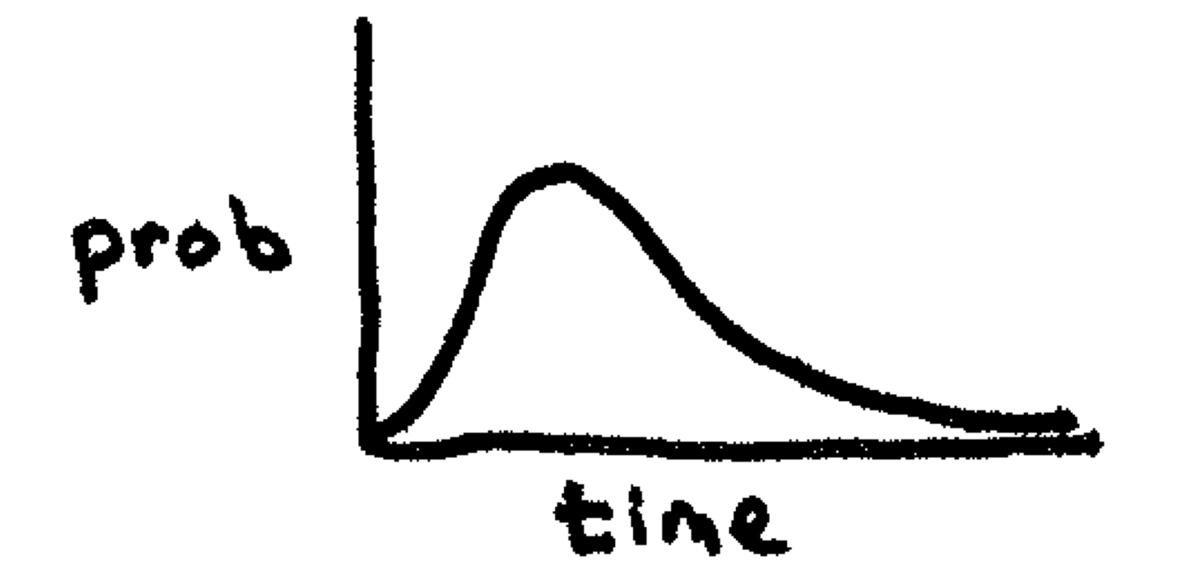
Data and Model
Maybe it's not dice at all
Could be number of minutes of phone calls
Historical data shows this follows a gamma curve
Shape is fixed but two numbers control center and 'flatness'
result | count
1 | 0
2 | 7
3 | 26
4 | 45
5 | 119
6 | 70
result | count
7 | 31
8 | 14
9 | 6
10 | 0
11 | 4
12 | 2

Slide 22
Data and Model
General theory of how data got generated, together with a set of parameter estimates is called a model
Questions:
Given a theory T, how do we know if one set of parameter estimates is better than another?
Which is better: theory T with parameters t or theory S with parameters s?
i.e. is one theory in general better than another?
can we automatically identify the best model (best theory+param combination)?
?
result | count
1 | 0
2 | 7
3 | 26
4 | 45
5 | 119
6 | 70
result | count
7 | 31
8 | 14
9 | 6
10 | 0
11 | 4
12 | 2
BIG MACHINE LEARNING QUESTIONS!

Slide 23
Data and Model
Ask the data!
For data D and models m in M, find argmax_{m} P(m|D)
By Bayes' rule this is equal to argmax_{m} P(m) P(D|m)
If we don't have any prior preferences, i.e. distribution over M is uniform, then it's just argmax_{m} P(D|m)
does this model look
generally good?
given the model,
does the data look reasonable?

Slide 24
Determining P(D|m)
SAMPLE
Quantitative!
Get some D (a sample)
apply each m
P(D|m) = ∏_{d∈D}P(d|m)
m1: ½ * ½ * ½ * ½ = .0625
m2: ¾ * ¾ * ¼ * ¾ = .105
m3: 9/10 * 9/10 * 1/10 * 9/10 = .073
argmax_{m}P(D|m) = m2
This is the maximum likelihood estimation (MLE)
Model | P(H) | P(T)
m1 | .5 | .5
m2 | .75 | .25
m3 | .9 | .1
m2!

Slide 25
What if we have an opinion about M?
M | P(M)
m1 | .9
m2 | .1
m3 | .1
e.g. the coin doesn't look biased
We could also compare the d12 vs 2d6 theories using the same technique!

Slide 26
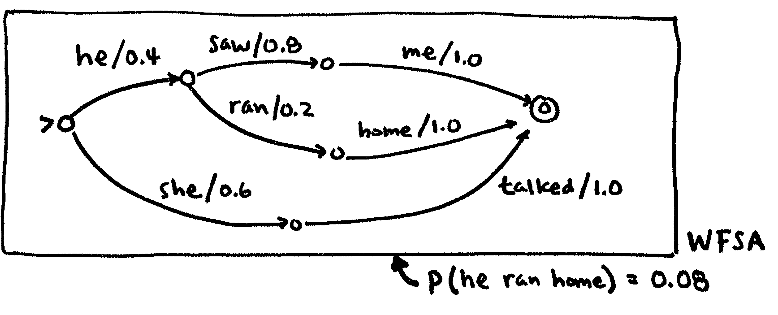
Adding Probabilities to FSA
Aside from a label, FSAs can have a weight; then they're weighted finite-state automata (wFSA)
If the weights of arcs leaving a path sum to 1 (final state excluded) it's probabilistic (pFSA)
Weight of a path = product of the weights of the arcs
Notes:
Sums the products of probabilities of every path!
0.4*0.8*1 + 0.4*0.2*1 + 0.6*1 = 1

Slide 27
pFSA is a way to encode P(A)
"she talked" = .6
"he saw me" = .32
"he ran home" = .08

Slide 28
wFSA is just a weighted graph
We can use best-path algorithms (Dijkstra) to efficiently find the most probable path (after converting to log space)
We can use FSA intersection to efficiently look up the probability of a sentence

Slide 29
Adding Probabilities to FST
FSTs can also have weighted arcs
If the weights of all outgoing arcs from a state with the same input symbol sum to 1, it's a pFST
FST transduces string x into string y
pFST transduces x into y with probability P(y|x)
Note: probabilities no longer reversable!

